Slide 1
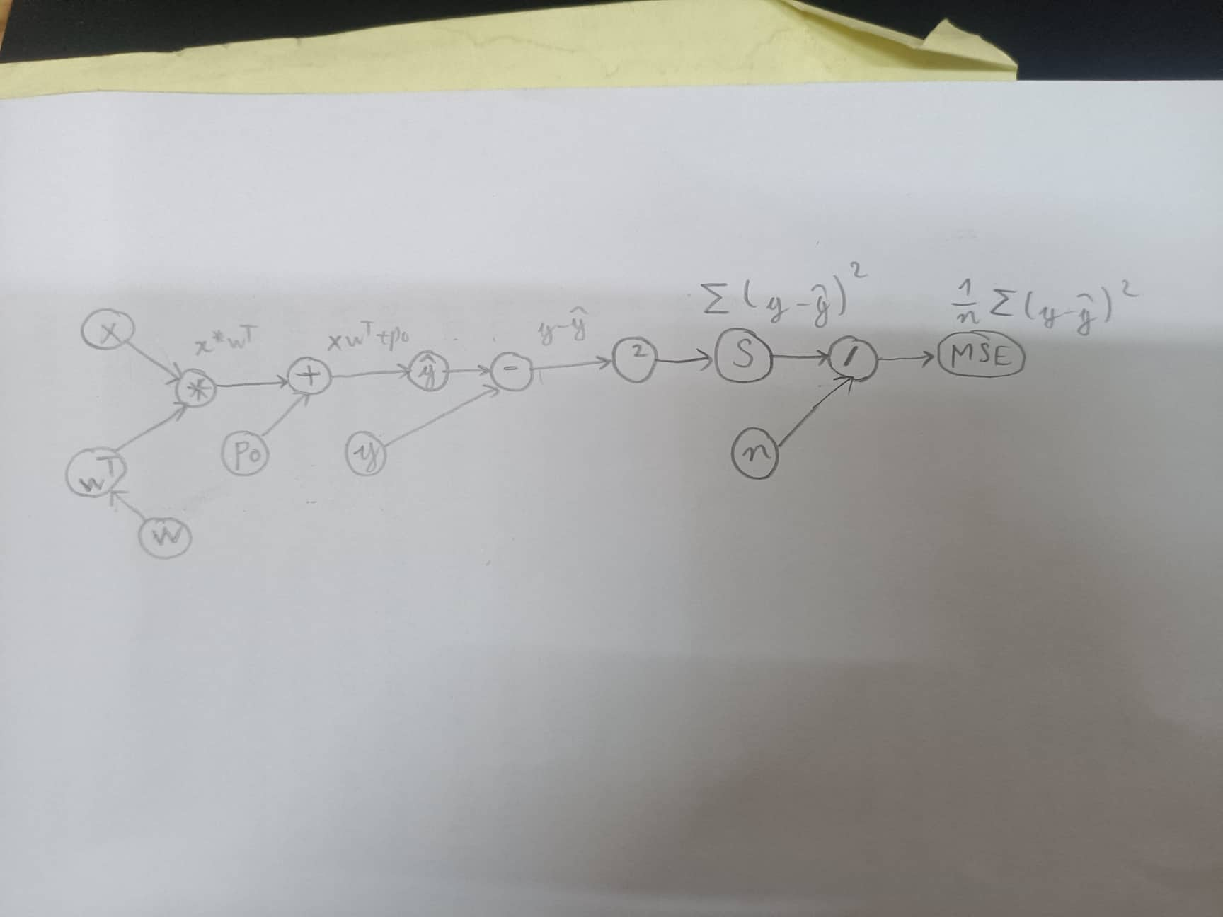
Câu 1

Slide 2
Câu 2
1
1
x
4/5 -7/5
4/5 -7/5
7/5 -7/5
4/5 -4/5
2/5 -7/5
4/5 -9/5
21/25 -21/25
12/25 -12/25
*
+
-
2
3/5
1
w ^T
4/5 -7/5
Po
y
w
4/5
-7/5

